Slide 1




Cook it yourself

Slide 2

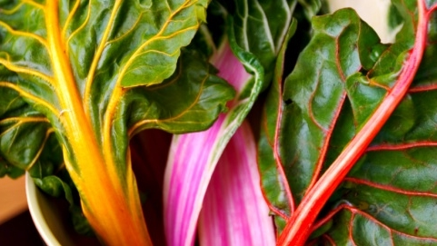

agenda
Weekly progress
Next steps
project progress

Slide 3
Weekly progress
Iitem1
Item2

Slide 4
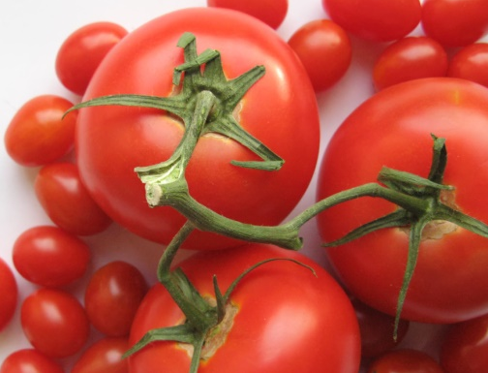
Next steps
item1
item2
item3

Slide 5
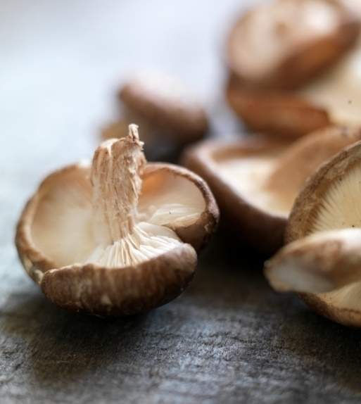
project progress

Slide 6
Thank you

